Slide 1
Vinyl Cutting
ISS solar cells
Chen Deng
Raindrop8888@gmail.com
440-382-3839 (cell)

Slide 2
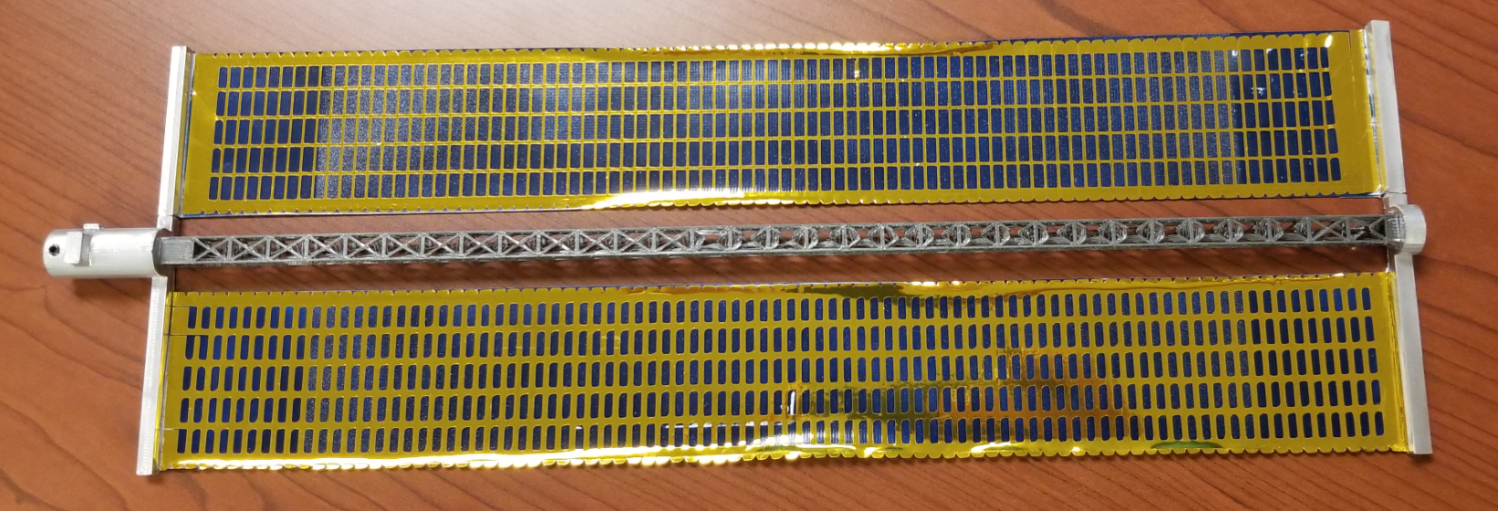
Goal
Quantity needed: 24 panels. 5 panels per sheet, therefore need 5 cuts
Size setting: 32 cm x 4.5 cm
32 cm
4.5 cm

Slide 3
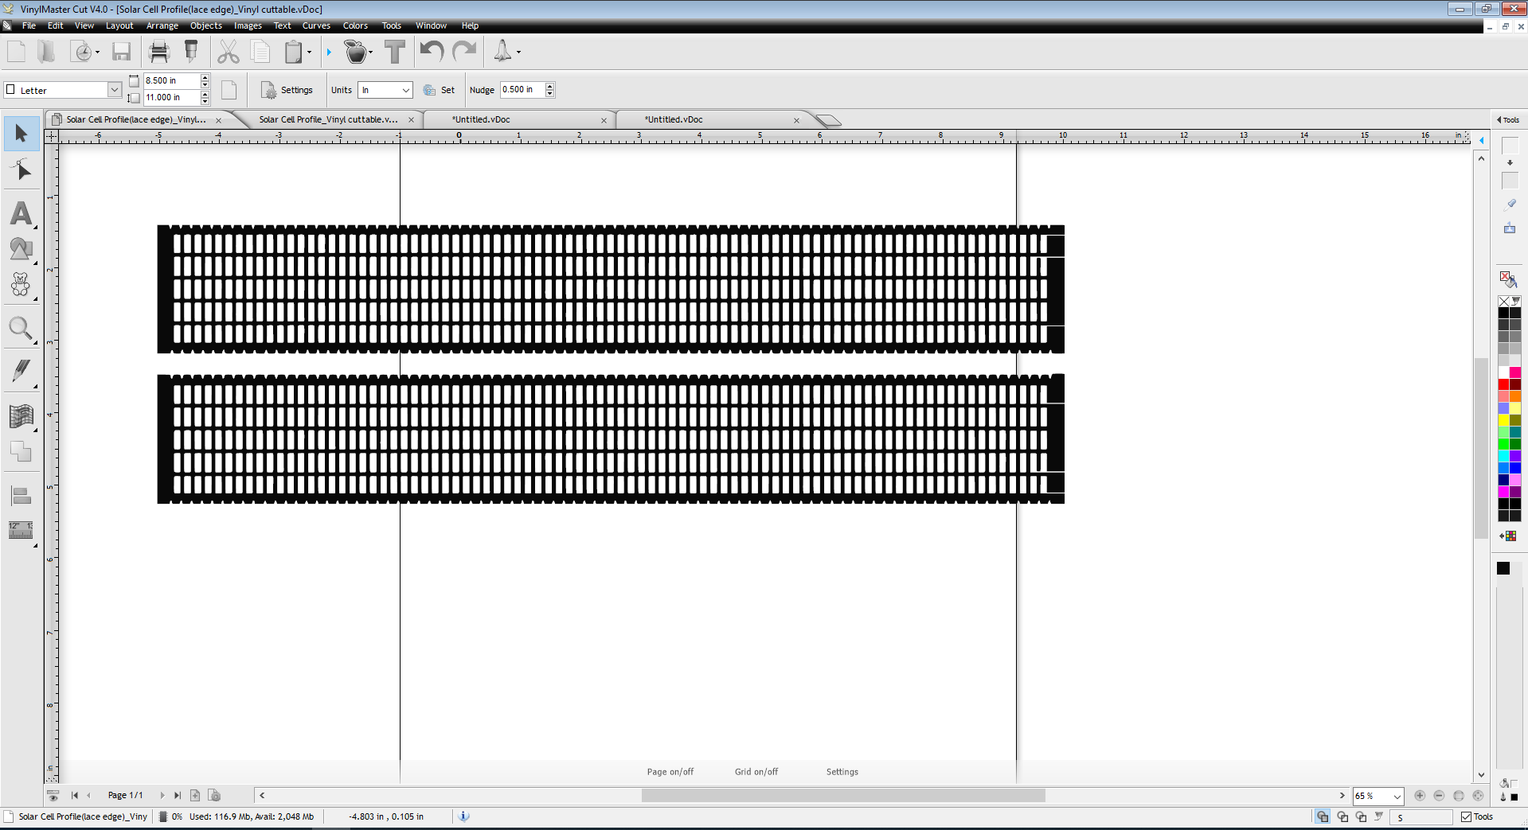
File -> import
(If import image doesn't have the nice lacy edges, see lessons learned page below)

Slide 4
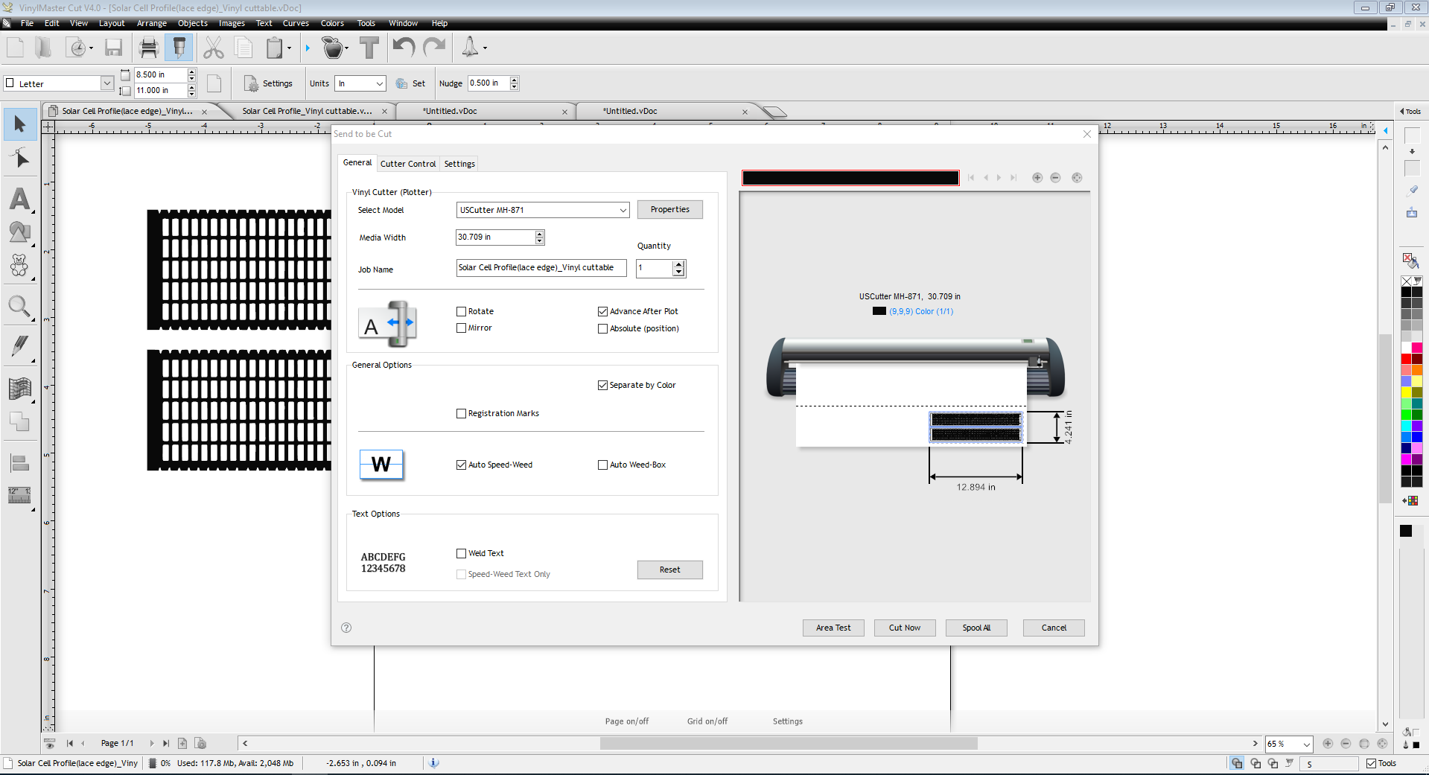
Cut icon

Slide 5
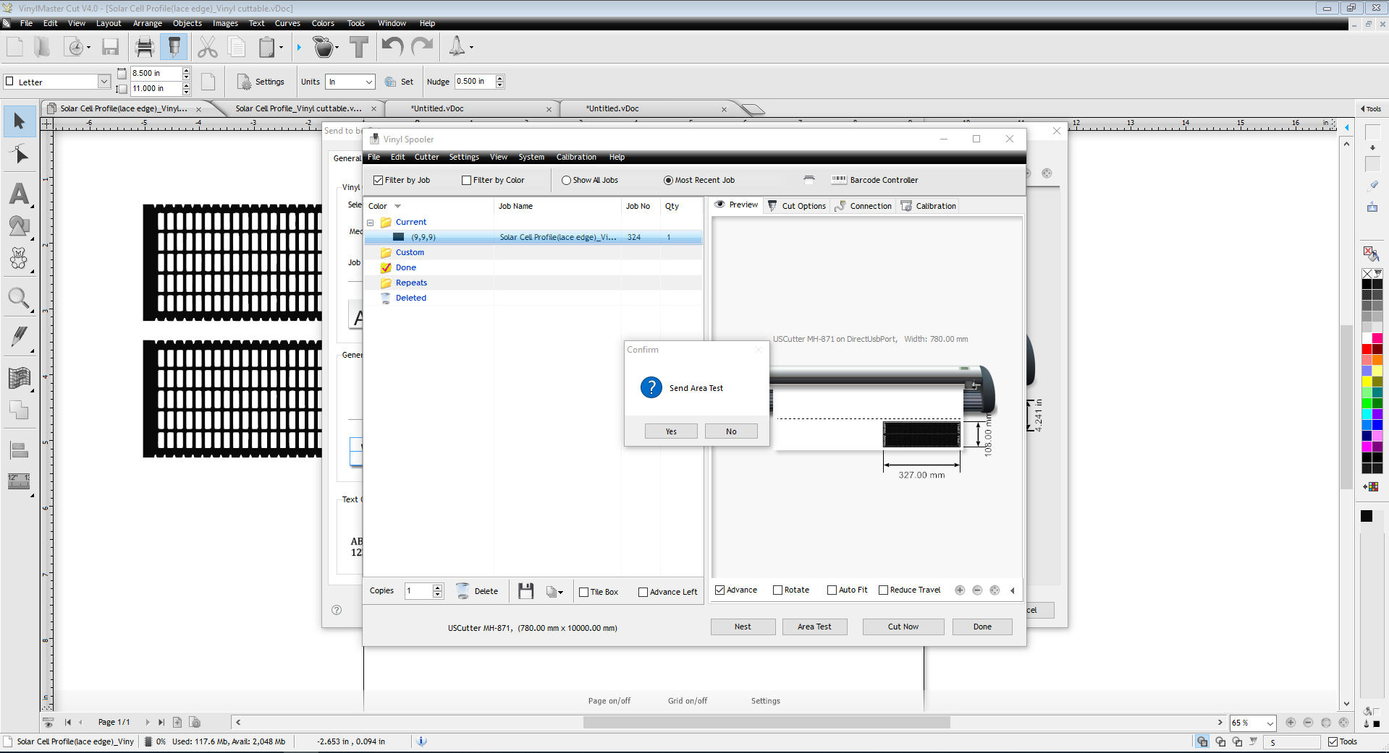
Area Test (This will allow cutter to show the area to be cut, to make sure vinyl is in the correct area)

Slide 6
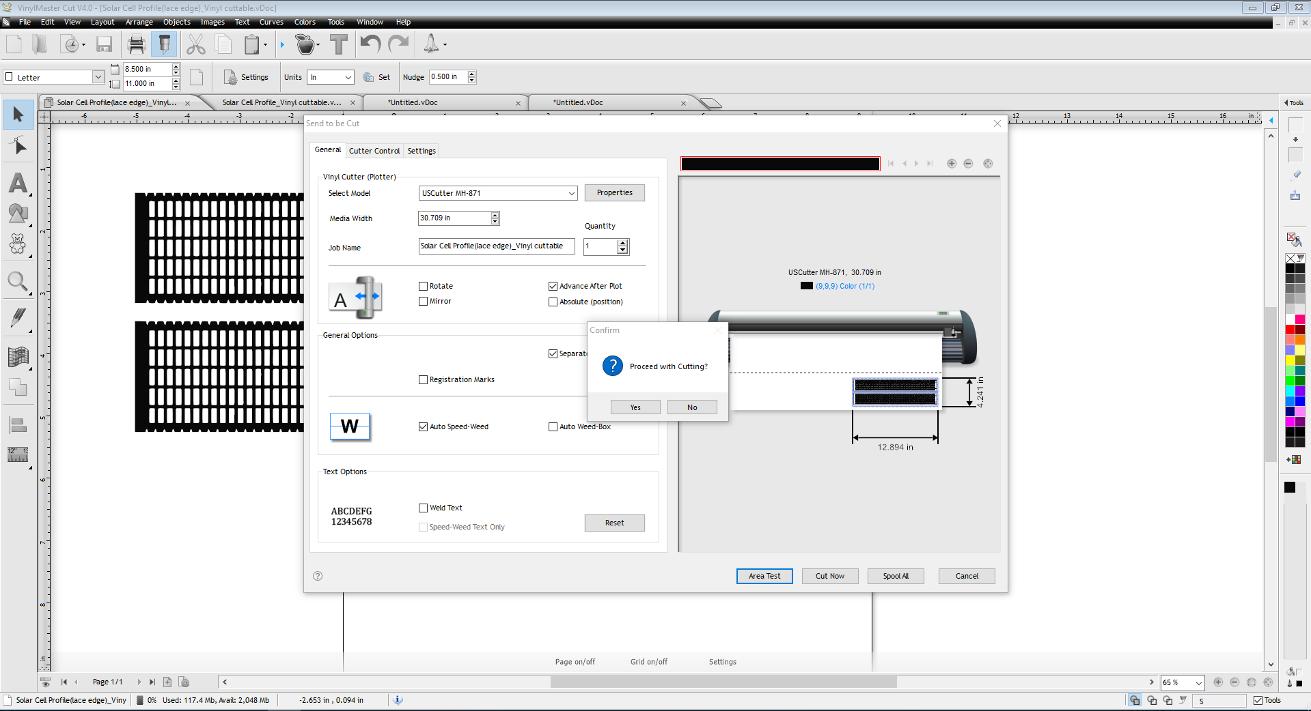
Cut confirmation

Slide 7
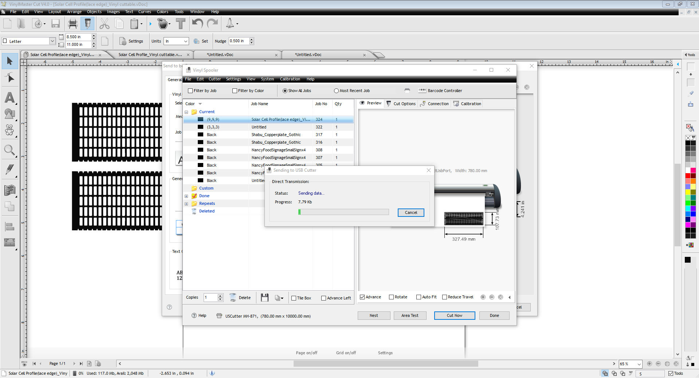
Cut Now – Command to cut Vinyl

Slide 8
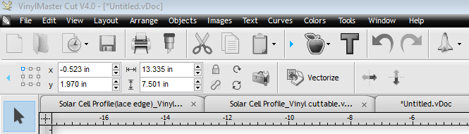
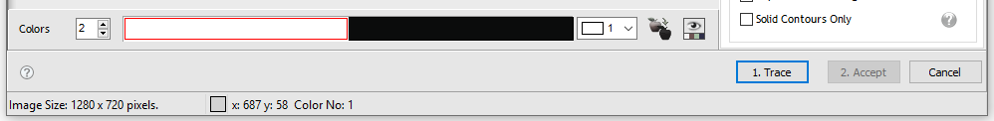
Lessons Learned: Issue(s) encountered
Issue 1: SVG file did not import properly. Aka, image was did not display correctly, no lacy edges
Work around: Imported SVG to Inkscape, then export to PNG. This make a screen shot of image. Then import PNG file to VinylMast Cut V4.0
Issue 2: VinylMaster Cut V4.0 gave error (Nothing to cut)
Work around: While in VinylMaster program:
- Click “Vectorizer”
- Click “trace”
http://forum.uscutter.com/index.php?/topic/53598-vinylmaster-cut-trace-issue/

Slide 9
What file type need for Vinyl cutting at Freeman Branch Library
Program to used for cutting is VinylMaster Cut V4.0, which has extension of .vDoc
Files type can be imported:
SVG file
Adobe Illustrator file
PNG file

